Slide 1
Credit Card Lead Prediction
Approach Document
By Kajal Kumar Ghosh

Slide 2
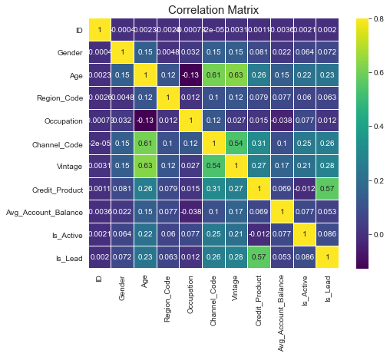
Credit Card Lead Prediction
A brief on the approach, which you have used to solve the problem.
What data-preprocessing / feature engineering ideas really worked? How did you discover them?
What does your final model look like? How did you reach it?
Read the train and test dataset. Check for missing data if any. Done the EDA to find the best matching features like Age, Vintage, Credit product, channel code, etc.

Slide 3
Credit Card Lead Prediction
Split the train data with Is_Lead as target variable and rest columns with other dataset. Done the label encoding for all the categorical columns. Removed the unique key columns from both the test and training dataset.
Then performed the various ML algorithm predictions e.g. LogisticRegression, RandomForestClassifier, GaussianNB, DecisionTreeClassifier, AdaBoostClassifier, KNeighborsClassifier, GradientBoostingClassifier.
Based on the predicted value, DecisionTreeClassifier and RandomForestClassifier. XGB Classifier gave us greater result of more that 99%.

Slide 4
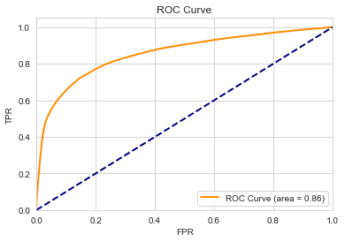
Credit Card Lead Prediction
We choose XGB Classifier is the fittest prediction.
Then we split the training data, predict on test data and plot ROC curve. We found out 86% accuracy on test data.

Slide 5
Credit Card Lead Prediction
Thank you.

